Slide 1
MIKE 11
Network Editor

Slide 2
NETWORK EDITOR
Plan View, River Branches and Hydraulic Structures definition
Network Editor (.nwk11)
Cross Section Editor (.xns11)
Simulation Editor (.sim11)
Boundary Editor (.bnd11)
Parameter Editor (.HD11)
Time Series Editor (.dfs0)

Slide 3
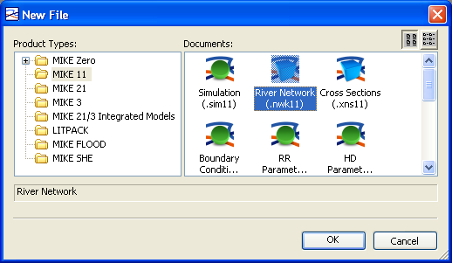
NETWORK EDITOR
*.NWK11 File Extension
How? MIKE Zero -> File -> New -> File -> MIKE 11 -> River Network (.nwk11)
Network File Displays Points, Branches, Structures and Data from Other Editors

Slide 4
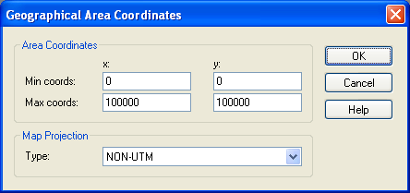
NETWORK EDITOR
Area Coordinates and Projection
How? MIKE Zero -> File -> New -> File -> MIKE 11 -> River Network (.nwk11)

Slide 5
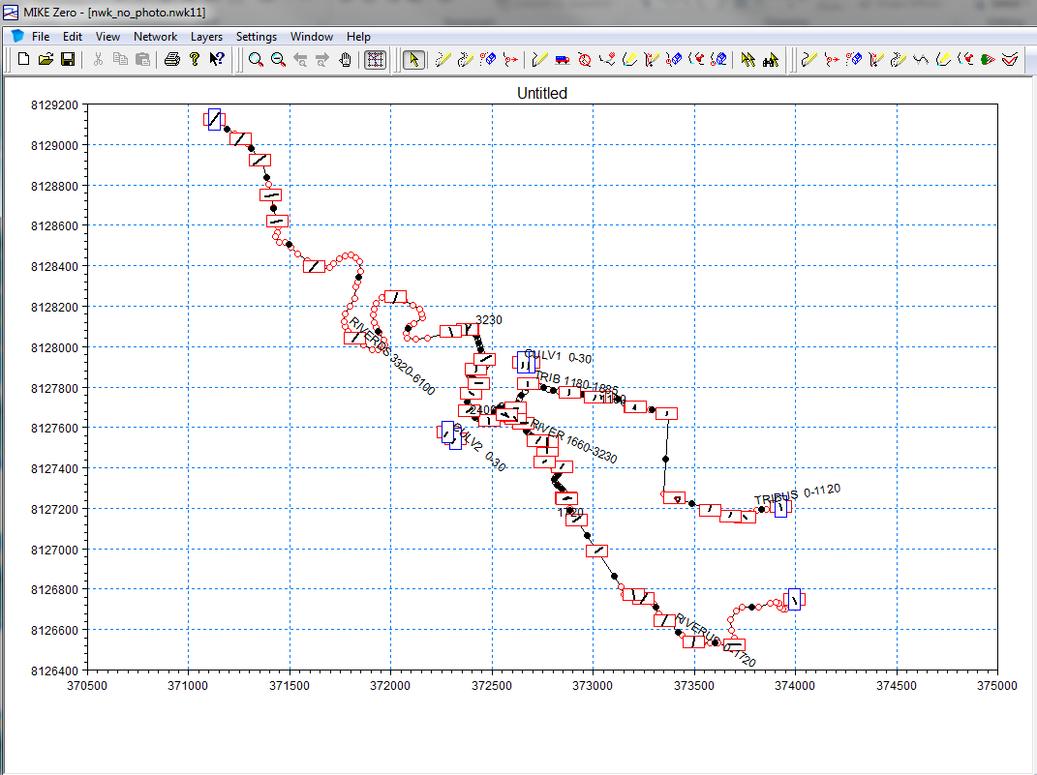
NETWORK EDITOR
Graphical View
The Graphical View displays the model branch network and background images

Slide 6
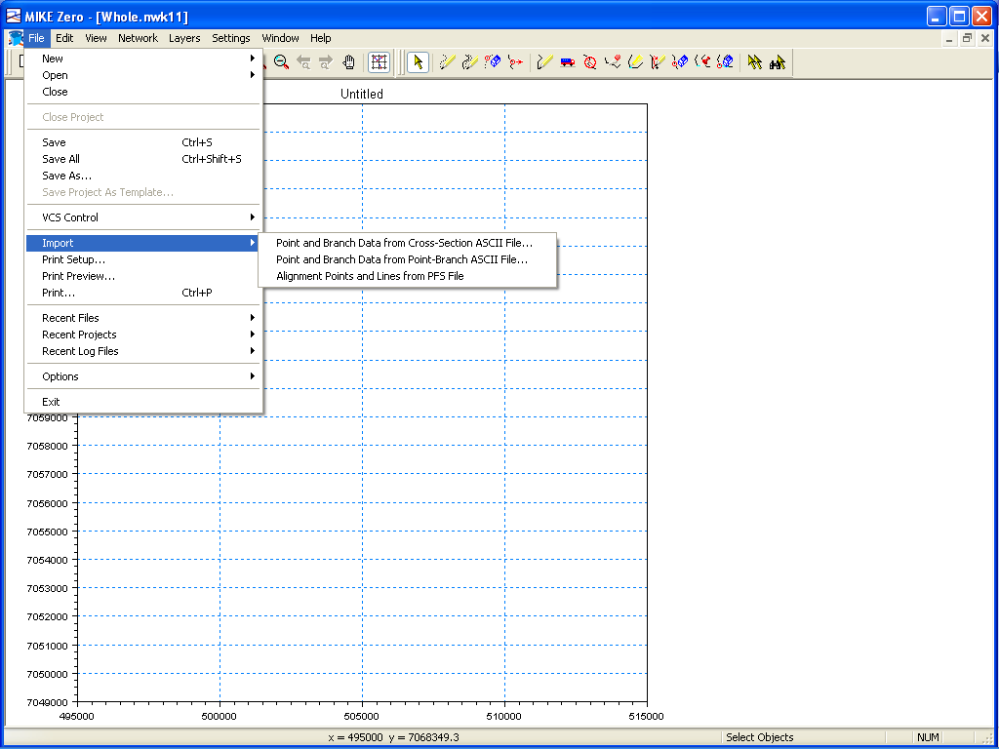
NETWORK EDITOR
File Options (includes Import from ASCII)
How? MIKE Zero -> File
Import branch and point data from ASCII format
Also import from shapefile available

Slide 7
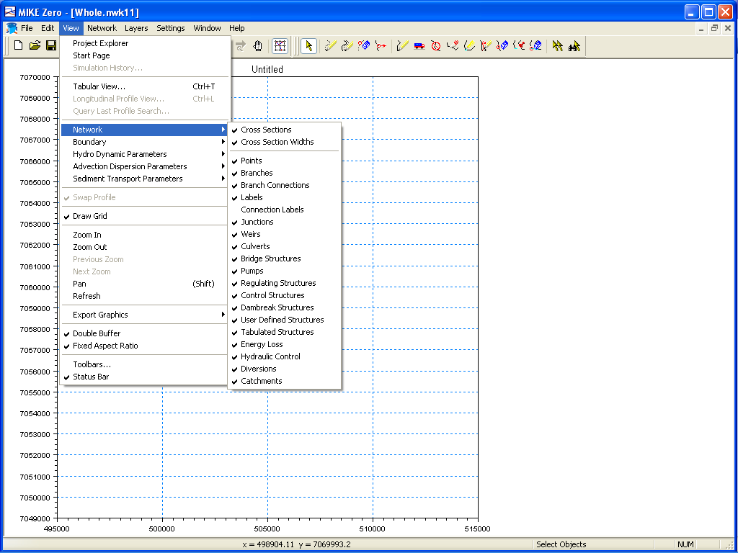
NETWORK EDITOR
View Options (includes Display Settings)
How? MIKE Zero -> View
Select Items from Other Editors that will be Displayed

Slide 8
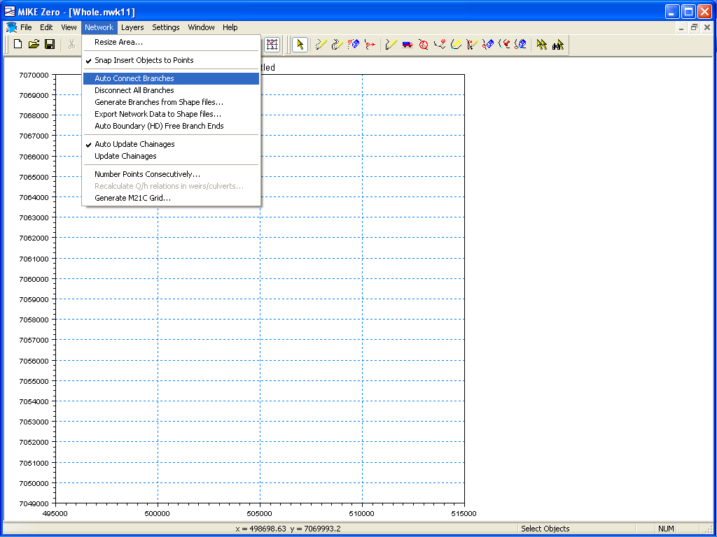
NETWORK EDITOR
Network Options (includes Automatic Tools)
How? MIKE Zero -> Network
Automatic Tools for Repetitive Tasks
Import and Export Data to Shape File

Slide 9
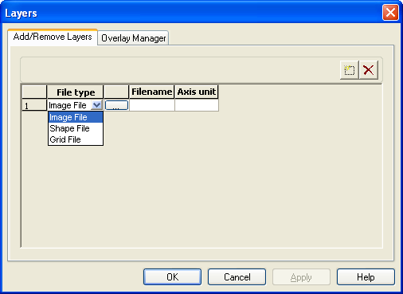
NETWORK EDITOR
Layer Options (Add/Remove)
How? MIKE Zero -> Layers -> Add/Remove
Add Images, Shape Files and MIKE 21 Grid Files (DFS2) in the background
Change the Display Order with Overlay Manager
Add New Layer

Slide 10
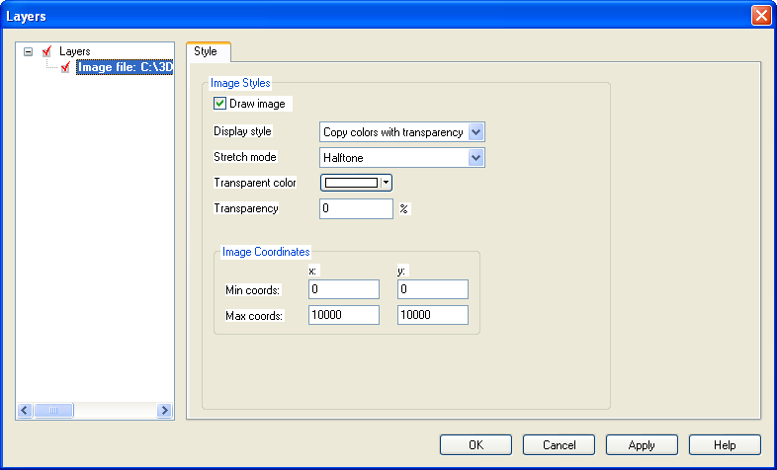
NETWORK EDITOR
Layer Options (Properties)
How? MIKE Zero -> Layers -> Properties
Change the Properties of Layers

Slide 11
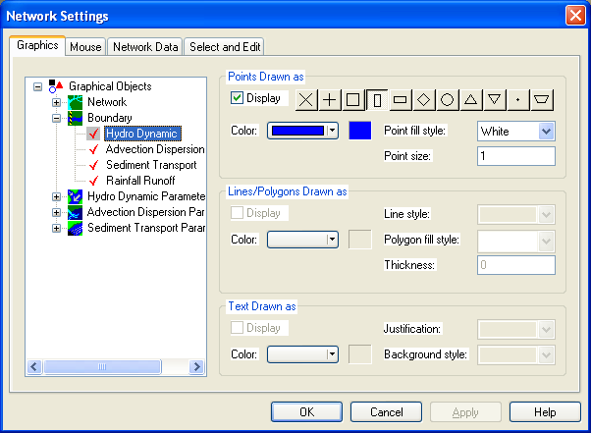
NETWORK EDITOR
Settings Options (Network)
How? MIKE Zero -> Settings -> Network (Graphics)
Change the View Properties of MIKE11 Objects

Slide 12
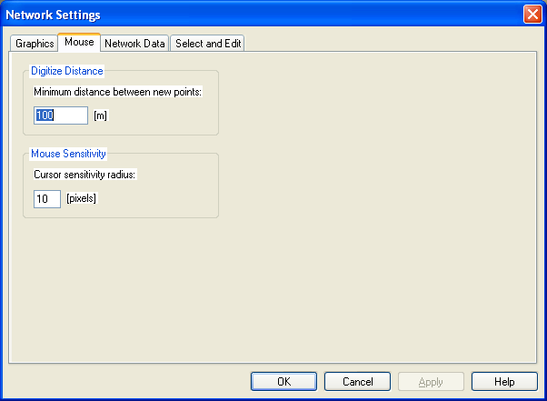
NETWORK EDITOR
Settings Options (Network)
How? MIKE Zero -> Settings -> Network (Mouse)
Change the Mouse Settings for Digitising and Selecting Objects

Slide 13
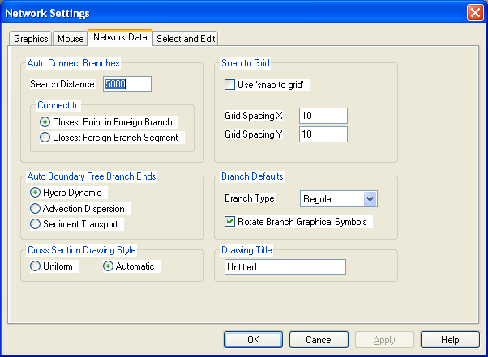
NETWORK EDITOR
Settings Options (Network)
How? MIKE Zero -> Settings -> Network (Network Data)
Change the Settings for Network Data

Slide 14
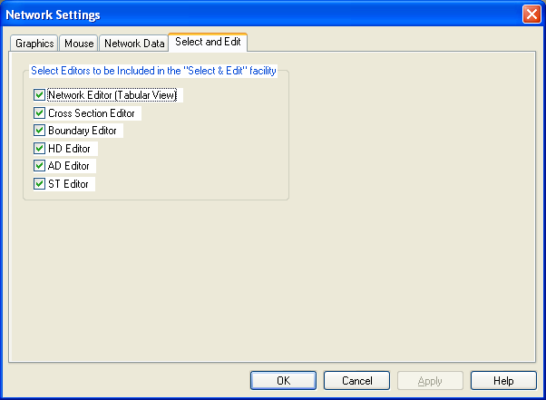
NETWORK EDITOR
Settings Options (Network)
How? MIKE Zero -> Settings -> Network (Select and Edit)
Change the Editors that are Dynamically Linked for Editing

Slide 15
NETWORK EDITOR
Graphical Tools
Zoom In
Add New Points
Zoom Out
Add New Points to Last Active Branch
Previous Zoom
Delete Points
Next Zoom
Move Points
Define Branch (connect points)
Pan
Cut Branch into Two
Draw Grid
Merge Branches into One
Select Objects
(cancel active tool)
Insert Points
Select order is important for some tools (eg. merge branches and insert points)
Exclude Points
Connect Branch
Disconnect Branch

Slide 16
NETWORK EDITOR
Full Right Click Functionality in Graphical View
How? MIKE Zero -> Graphical View -> Right Click (on Points and Branches)
Inserting Objects will Open Relevant Editor
Edit Function Lists all Objects based on Zoom Scale and Cursor Sensitivity Radius

Slide 17
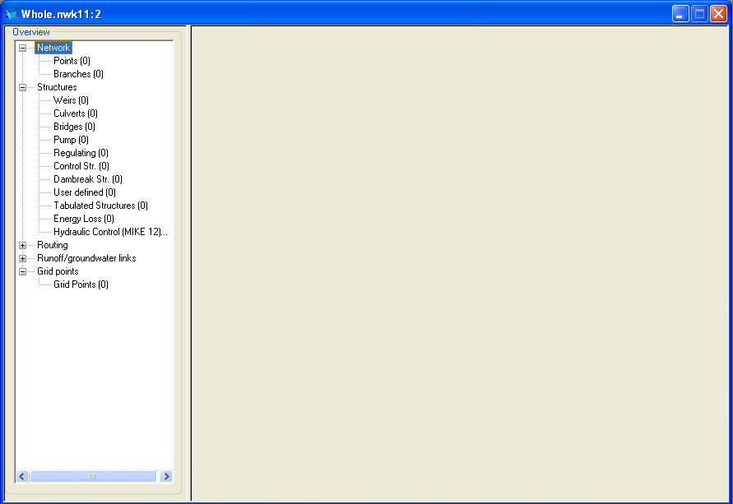
NETWORK EDITOR
Tabular View
How? MIKE Zero -> View -> Tabular View (or short cut: Ctrl + t)
The Tabular View Displays all Model Setup Data including Structures
Tabular Data is Dynamically Linked to the Graphical View

Slide 18
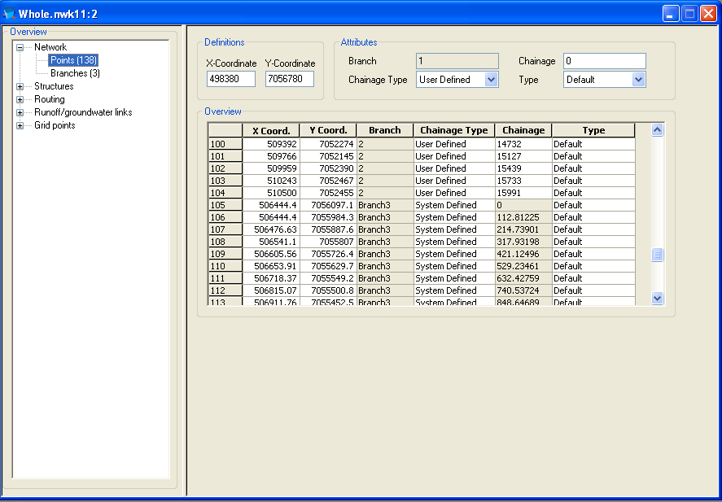
NETWORK EDITOR
Copy/Paste
to/from Excel
for Global Editing
Points Page
The Points Page Contains a List of all Digitised Points in the Model Setup
Editing in Overview
or Data Entry Panel
Chainage is
“User Defined” or
“System Defined”
based on Scaled
(Linear) Distance
Between Points

Slide 19
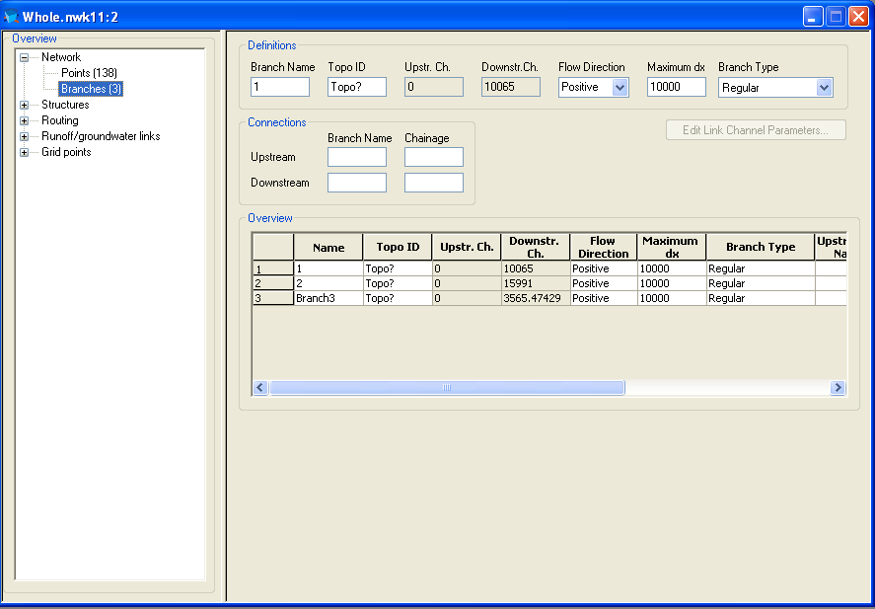
NETWORK EDITOR
Branches Page
The Branches Page
Contains Details on
Type of Branches, Direction and Model Connectivity

Slide 20
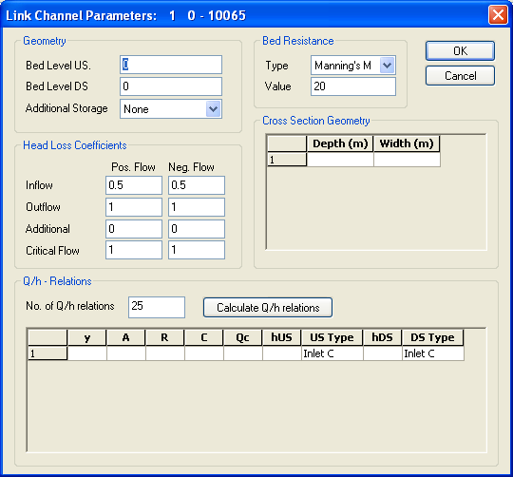
NETWORK EDITOR
Branch Details
Topo ID
Provides a linkage to the Cross-Section
Database and allows quick change of
geometry along a Branch (ie. sections surveyed at different times)
Maximum dx
The density of computational H-points along a Branch is smaller than this value.
Link Channels
A special type of Branch that can be used to define flow between channel and floodplain

Slide 21
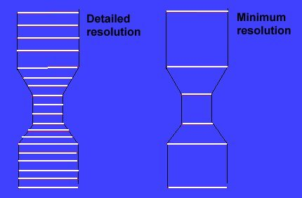
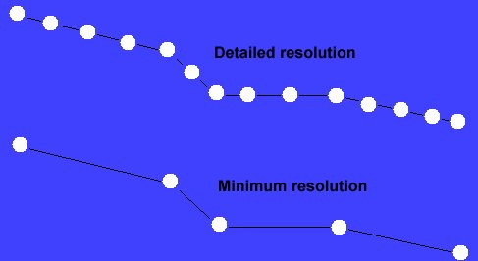
NETWORK EDITOR
Grid point spacing in river branches (Maximum dx)
Chainage [m] : 20.000 28.000 32.000 40.000
Maximum dx = 5.000 m
Maximum dx = 3.000 m
Maximum dx > 8.000 m
H-point with cross section from Database
H-point with interpolated Cross Section
Q-point
Horizontal discretisation
Vertical discretisation

Slide 22
NETWORK EDITOR
Setup of Channel Network
River A
0.000 - 10.400
0.000
3.000
River B
3.000 - 15.000
10.400
15.000
15.000
River C
15.000 - 25.000
25.000
Name Upstream Downstream Upstream Downstream
End End Connection Connection
River A 0.000 10.400 - River C 15.000
River B 3.000 15.000 - River C 15.000
River C 15.000 25.000 River B 15.000 -

Slide 23
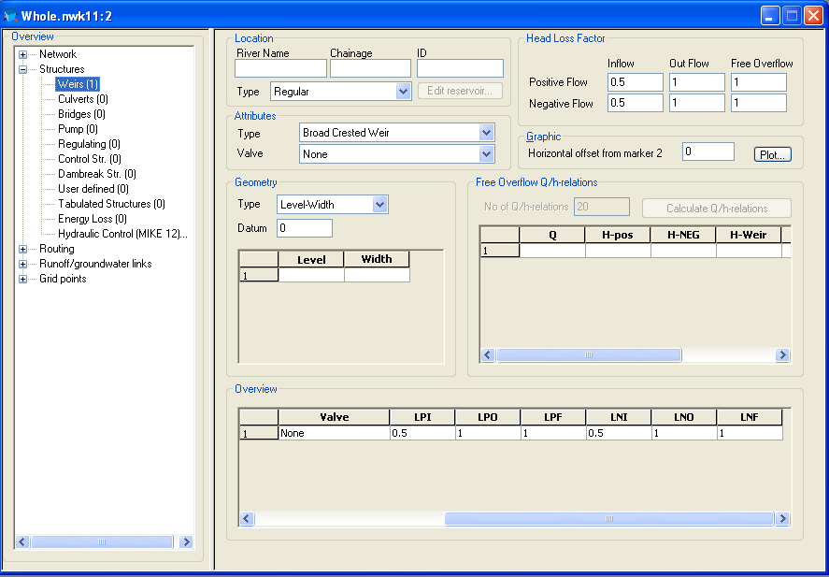
NETWORK EDITOR
Plot the Position
Relative to U/S & D/S
Cross-Sections
Structures Page (Weirs)
The Weirs Page Contains a List of All Weirs in the Model and Options to Define Them
Q/h Relations must be Calculated Prior to Runtime

Slide 24
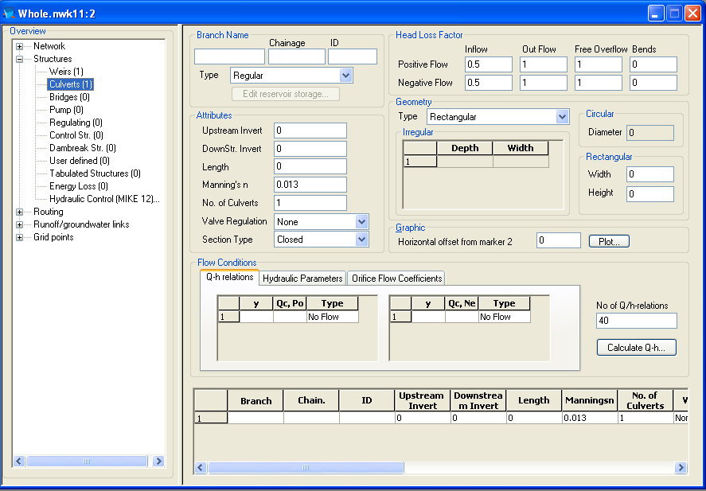
NETWORK EDITOR
Structures Page (Culverts)
Plot the Position
Relative to U/S & D/S
Cross-Sections
The Culverts Page Contains a List of All Culverts in the Model and Options to Define Them
Q/h Relations must be Calculated Prior to Runtime

Slide 25
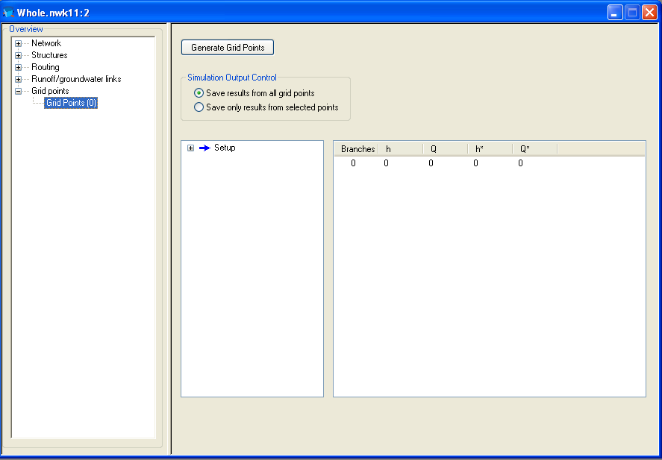
NETWORK EDITOR
Grid Points Page
The Grid Points
Page Provides a
Summary of H & Q
Points in the Model

Slide 26
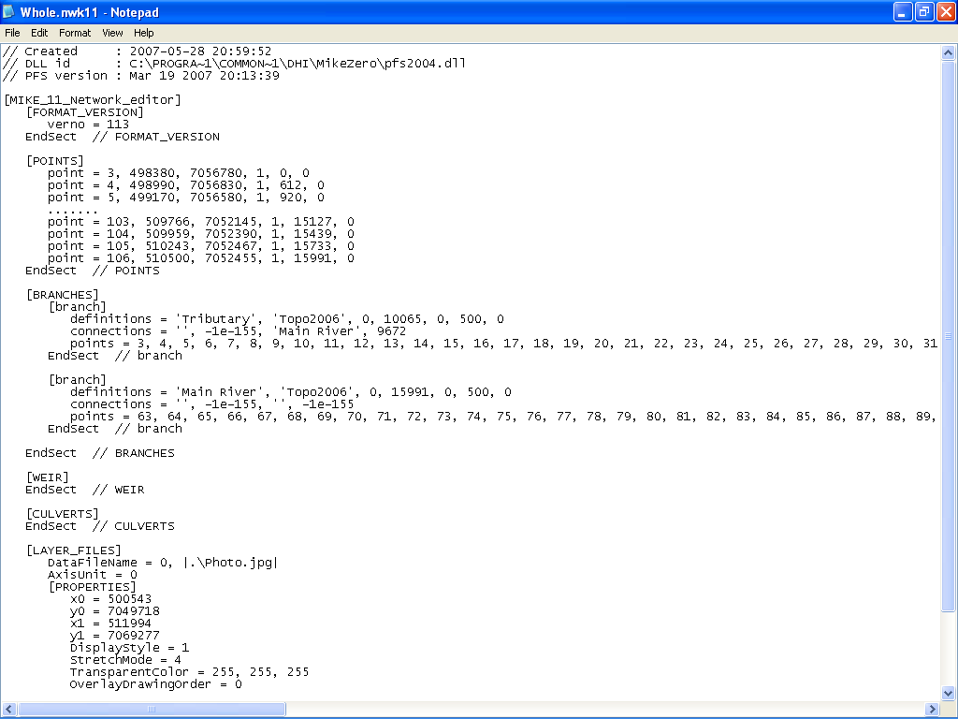
NETWORK EDITOR
Editable Text File
The Network File can be Edited in any Text Editor

